Slide 1

MUNICIPAL WASTE STREAM
Marjalino.Patel.Bozovic.Salmon.
ISSCM 491

Slide 2

EPA began gathering data on the disposal of materials and products in the United States
more than 30 years ago.
National Overview: Facts and Figures on Materials, Wastes and Recycling. (2018, August 17). Retrieved from https://www.epa.gov/facts-and-figures-about-materials-waste-and-recycling/national-overview-facts-and-figures-materials

Slide 3
Our data shows the story of the number of produced, recycled, combusted and landfilled
materials and products from 1960-2014.

Slide 4
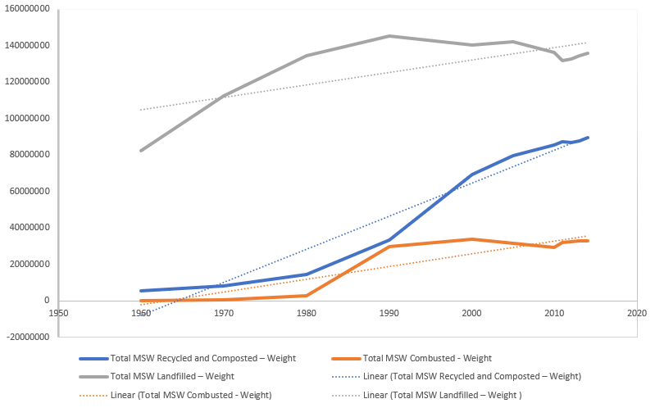
What is happening to our trash
Landfill usage is unstable and isn’t only increasing.
Yard Trimmings are not for the landfill
Food is highest at 22%
Community Specific
Landfill
~95% in 1960
~55% in 2014

Slide 5
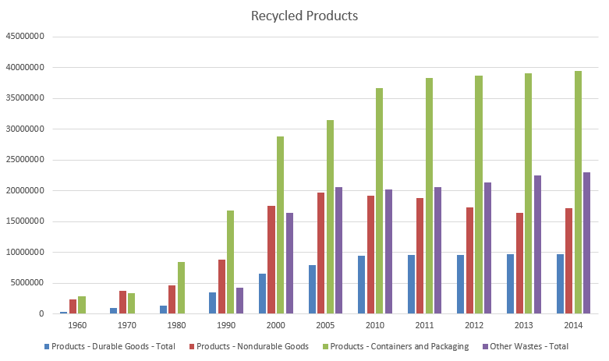
The most steady increase
Recycling is consistently rising
Focus on Sustainable material
Total recycled
1960: 6%
1980: 10%
1990: 16%
2014: 34.59%

Slide 6
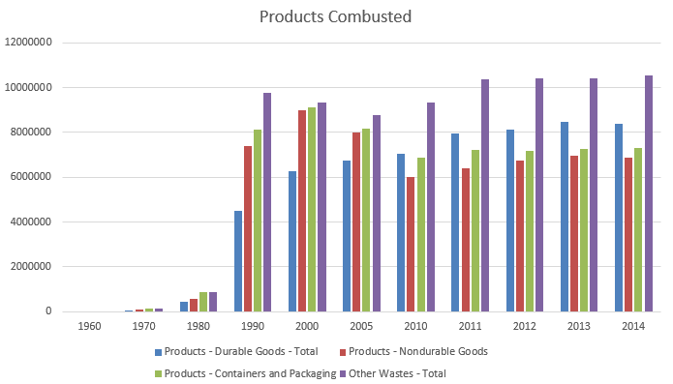
The great debate
Combustion is rising, but less consistently
Least Preferred
Other: Yard Trimmings, Food & Miscellaneous
Food is > 20% in 2014
Non-Hazardous only

Slide 7
WHY?
1981
The first city to mandate recycling in the US: Woodbury, New Jersey.
Initiatives to recycle grew in the 80s.
1985
The first incinerator in the United States was built in New york City.
By the 90s, hundreds of incinerators started operations in the United States.
Energy Recovery from the Combustion of Municipal Solid Waste (MSW). (2018, April 13). Retrieved from https://www.epa.gov/smm/energy-recovery-combustion-municipal-solid-waste-msw

Slide 8
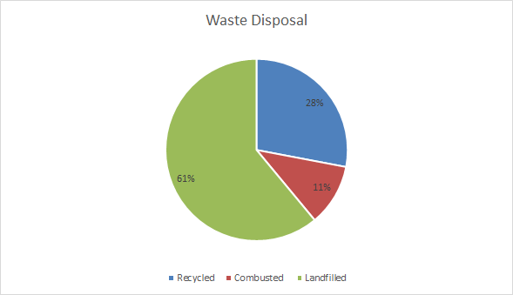
How is our Waste Disposed of?
On average, we produce 212,166,363.64 tons of waste each year in The United States
Most of our waste is landfilled at 61% of total generated, followed by 28% that is recycled, and 11% that is combusted
While looking at these findings, we discovered that most landfilled waste comes from paper products!
23% of all landfilled waste comes from paper
2 % of the 11% of waste that is combusted comes from paper
Why aren’t these materials being recycled?

Slide 9
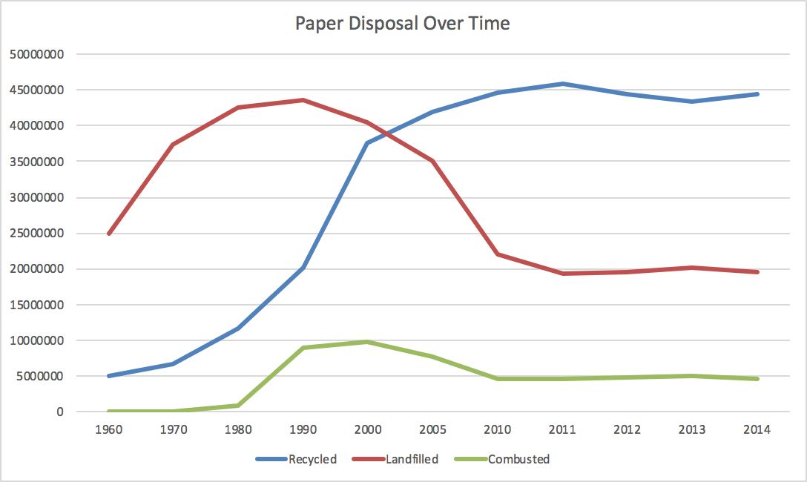
Paper Disposal Over Time
How have we disposed paper over time- have there been changes?
Recycling of paper products has greatly increased since 1960, with highest levels in recent years
Landfill usage has sharply decreased since 1960, but plateaued in recent years
Despite the improvements that have been made, paper is the most common product in landfills

Slide 10
This leads us to believe that the United States Waste Disposal system is not as efficient as it could be ...

Slide 11
As a result, we decided to explore how these products are being disposed of, and if there are any future recommendations we can make based on the data

Slide 12
TOP MATERIALS RECYCLED, COMBUSTED AND LANDFILLED
BASED ON MEANS PER MATERIAL FROM 1960-2014
GENERATED
1 PAPER
2 FOOD WASTE
3 YARD TRIMMINGS
4 PLASTICS
RECYCLED
1 PAPER
2 METALS
3 YARD TRIMMINGS
COMBUSTED
1 PAPER
2 FOOD WASTE
3 PLASTICS
LANDFILLED
1 PAPER
2 FOOD WASTE
3 PLASTICS

Slide 13
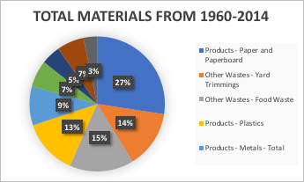
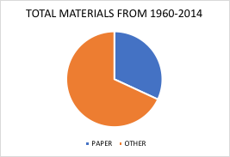
PERCENTAGE OF PAPER GENERATED VS OTHER MATERIALS

Slide 14
Is using paper really beneficial
to the reduction of waste?

Slide 15
Let’s look at the products landfilled...

Slide 16
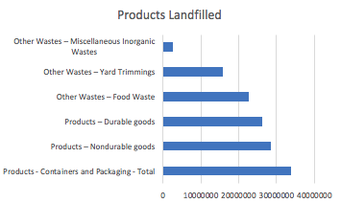
A closer look at products and landfill

Slide 17
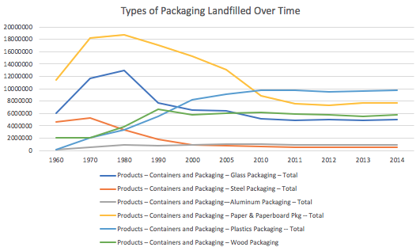
A closer look at packaging landfilled

Slide 18
What goes into a landfill?
According to EPA
“Materials and products go to landfills due to end-user choice or because recovery was not feasible.”

Slide 19
Our Data...
1960 - 2014
Following groups for materials generated:
Products - Paper and Paperboard
Products - Glass
Products - Metals - Ferrous
Products - Metals - Aluminum
Products - Metals - OtherNonferrous
Products - Metals - Total
Products - Plastics
Products - Rubber and Leather
Products - Textiles
Products - Wood
Products - Other
Products - Total Materials
Other Wastes - Food Waste
Other Wastes - Yard Trimmings
Other Wastes - Miscellaneous Inorganic Wastes
Other Wastes - Total
Total MSW Generated - Weight

Slide 20
Main Groups
- Products - Paper and Paperboard
- Products - Glass
- Products - Metals - Total
- Products - Plastics
- Products - Rubber and Leather
- Products - Textiles
- Products - Wood
- Products - Other
- Products - Total Materials
- Other Wastes - Total
2015

Slide 21
How Do We Estimate 2015’s Waste?
Confidence Intervals!
PE ± ME
PE = Mean of each group of generated materials throughout the years
ME = Margin of Error
ME = z*(σ/√n )
z = 1.96 (95% confidence interval)
σ = Standard Deviation of each group of generated materials throughout the years
n = 11 (years of data)
PE - ME = Low Interval
PE + ME = High Interval

Slide 22
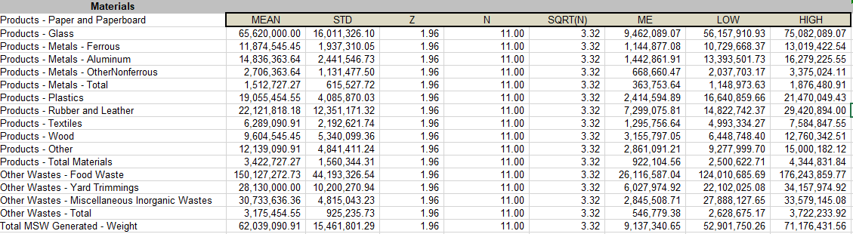
Excel Output for Materials Generated for Following Year

Slide 23
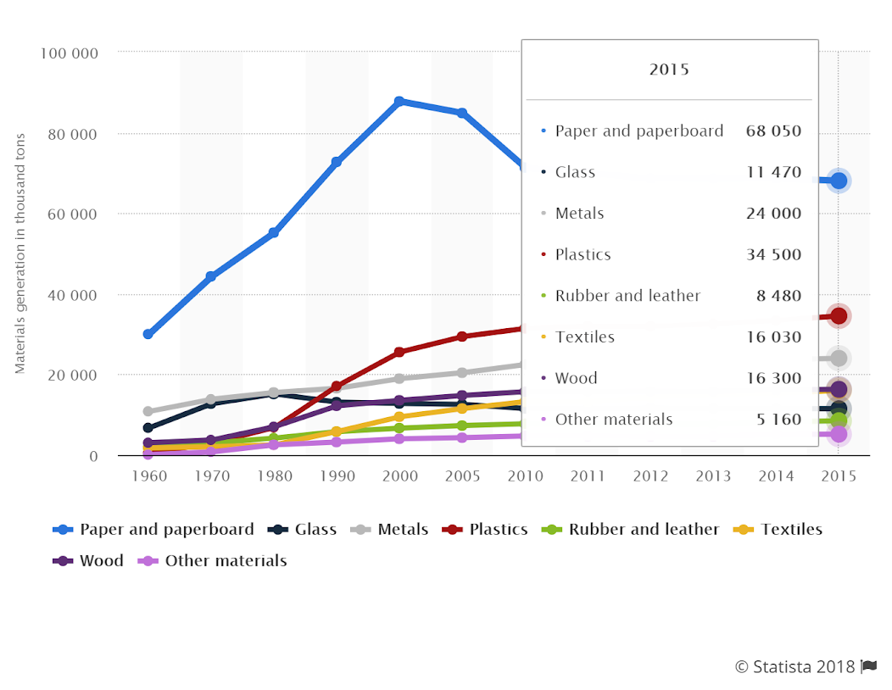
We are 95% confident that 2015’s expected generated waste will fall between...for the following groups:
ACTUAL GENERATED WASTE
- Products - Paper and Paperboard
- Products - Glass
- Products - Metals - Total
- Products - Plastics
- Products - Rubber and Leather
- Products - Textiles
- Products - Wood
- Products - Other
- Products - Total Materials
- Other Wastes - Total
- [56,157,911 and 75,082,089]
- [10,729,668 and 13,019,423]
- [16,640,860 and 21,470,049]
- [14,822,742 and 29,420,894]
- [4,993,334 and 7,584,848]
- [6,448,748 and 12,760,343]
- [9,278,000 and 15,000,182]
- [2,500,623 and 4,344,832]
- [124,000,000 and 176,243,860]
- [52,901,750 and 71,176,432]
Notes:
ADVANCEMENTS IN TECHNOLOGY - INCREASE IN METALS, PLASTICS
INCREASE IN PRODUCTION IN GENERAL

Slide 24
Future Recommendations
Upon examination of the large amount of paper products that ended up in landfills, we decided to recommend methods to increase the use of recycling in the United States
Although there are curbside recycling programs in place for most communities, municipal recycling is not required in all U.S. Cities
42% of Americans claim to always recycle, 48% sometimes recycle, and 10% never recycle
In an effort to raise participation rates, we recommend cities implement mandatory recycling laws
To further enforce recycling in municipalities, we recommend communities fine individuals that do not recycle their waste, and increase the fines for each repeated offense
In order to ensure the collection of all recycled goods is sustainable in the long-term, neighborhoods can increase the cost of waste collection
While there may be up-front costs associated with an implementation of such a program, the overall return of a proper recycling practices can make a great impact for a sustainable future, decreasing the environmental and health risks imposed by landfill use

Slide 25
Is it possible?

Slide 26
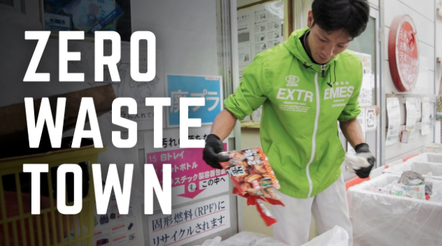
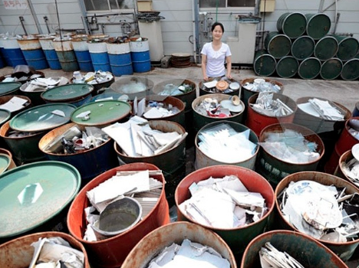
It’s already being done!
Kamikatsu, Japan
80% of all waste recycled. Goal is zero waste by 2020
They have 32 segregation bins in recycling centers, no garbage trucks.
In Yokohama, citizens are given a 27-page manual on how to sort more than 500 different items.
“If you get used to it, it becomes normal. Now I don’t think about it. It’s become natural to separate the trash correctly.” - Resident of Town

Slide 27
What you can do right now
Before using/ buying something, ask “Do I really need to use it?”
Plastic straws vs sipping from the cup
Bags vs putting it in your bag
Going for reusable containers instead of ziploc bags
Paper mail vs electronic mail
Ebook vs physical copy
Be mindful of food waste!

Slide 28
THANK YOU!

Slide 29
References:
“U.S. Municipal Waste Stream: Materials Generation 2015 | Statistic.” Statista, www.statista.com/statistics/185710/us-materials-generation-in-the-municipal-waste-stream-since-1960/.
“Recycling in the United States - Statistics & Facts.” Statista, https://www.statista.com/topics/1275/recycling-in-the-united-states/
Zero waste town:
https://www.youtube.com/watch?time_continue=279&v=eym10GGidQU

Slide 30
Management of waste continues to be concern on the local and global level.
National Overview: Facts and Figures on Materials, Wastes and Recycling. (2018, August 17). Retrieved from https://www.epa.gov/facts-and-figures-about-materials-waste-and-recycling/national-overview-facts-and-figures-materials

Slide 31
Data on how we have disposed of the materials and products that we use can help us see what we’ve been doing in the past years, and can help us plan accordingly for the future.
National Overview: Facts and Figures on Materials, Wastes and Recycling. (2018, August 17). Retrieved from https://www.epa.gov/facts-and-figures-about-materials-waste-and-recycling/national-overview-facts-and-figures-materials

Slide 32
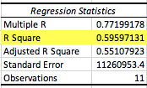
Predicting how much paper will be recycled
PAPER RECYCLED = 0.77*(Generated paper waste) - 19,249,070.3

Slide 33
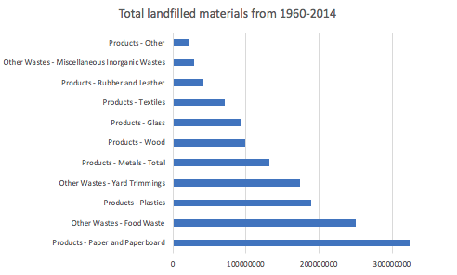
Landfilled materials

Slide 34
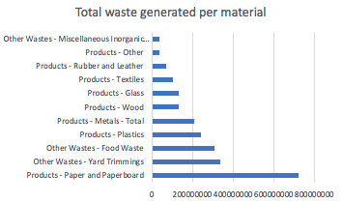
Landfilled materials

